Slide 1
TFL_Bus_Safety-Data viz with Tableau
File created on: 1/3/2023 3:55:27 AM

Slide 2
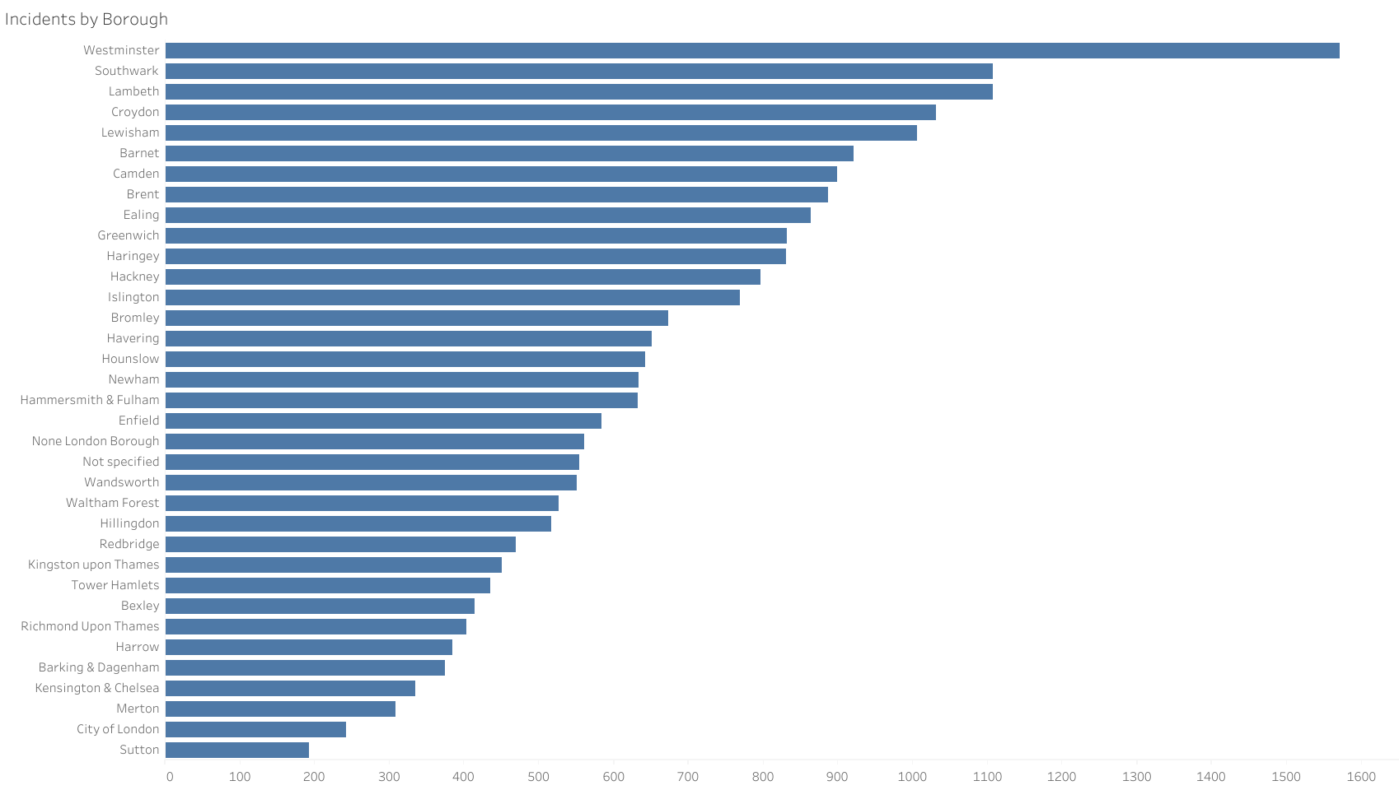

Slide 3


Slide 4
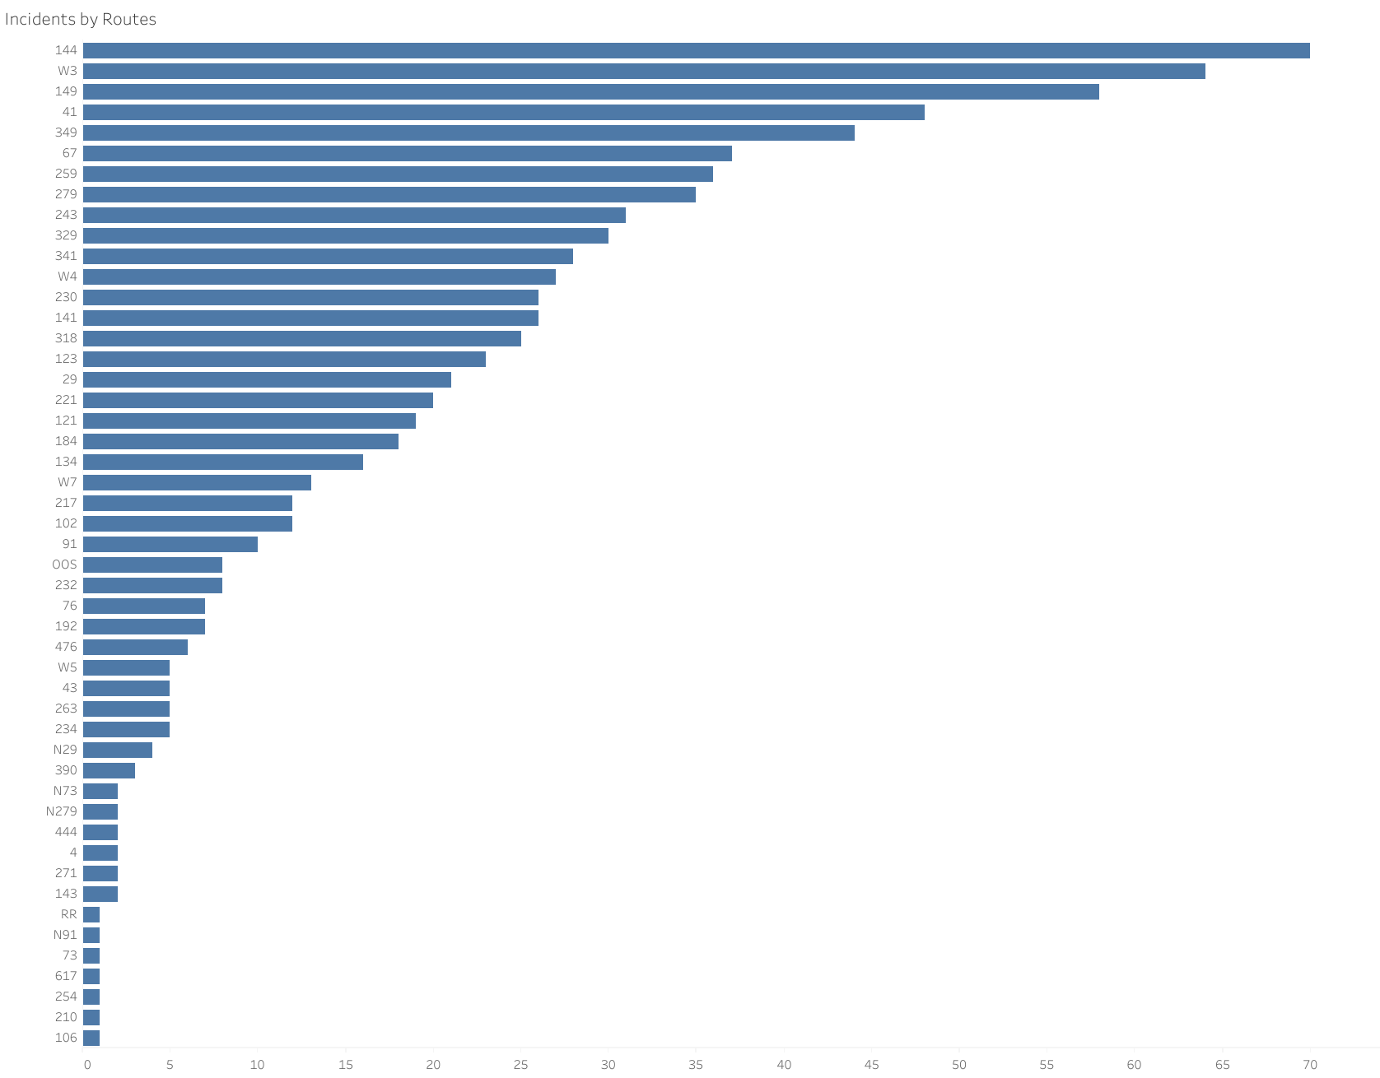

Slide 5
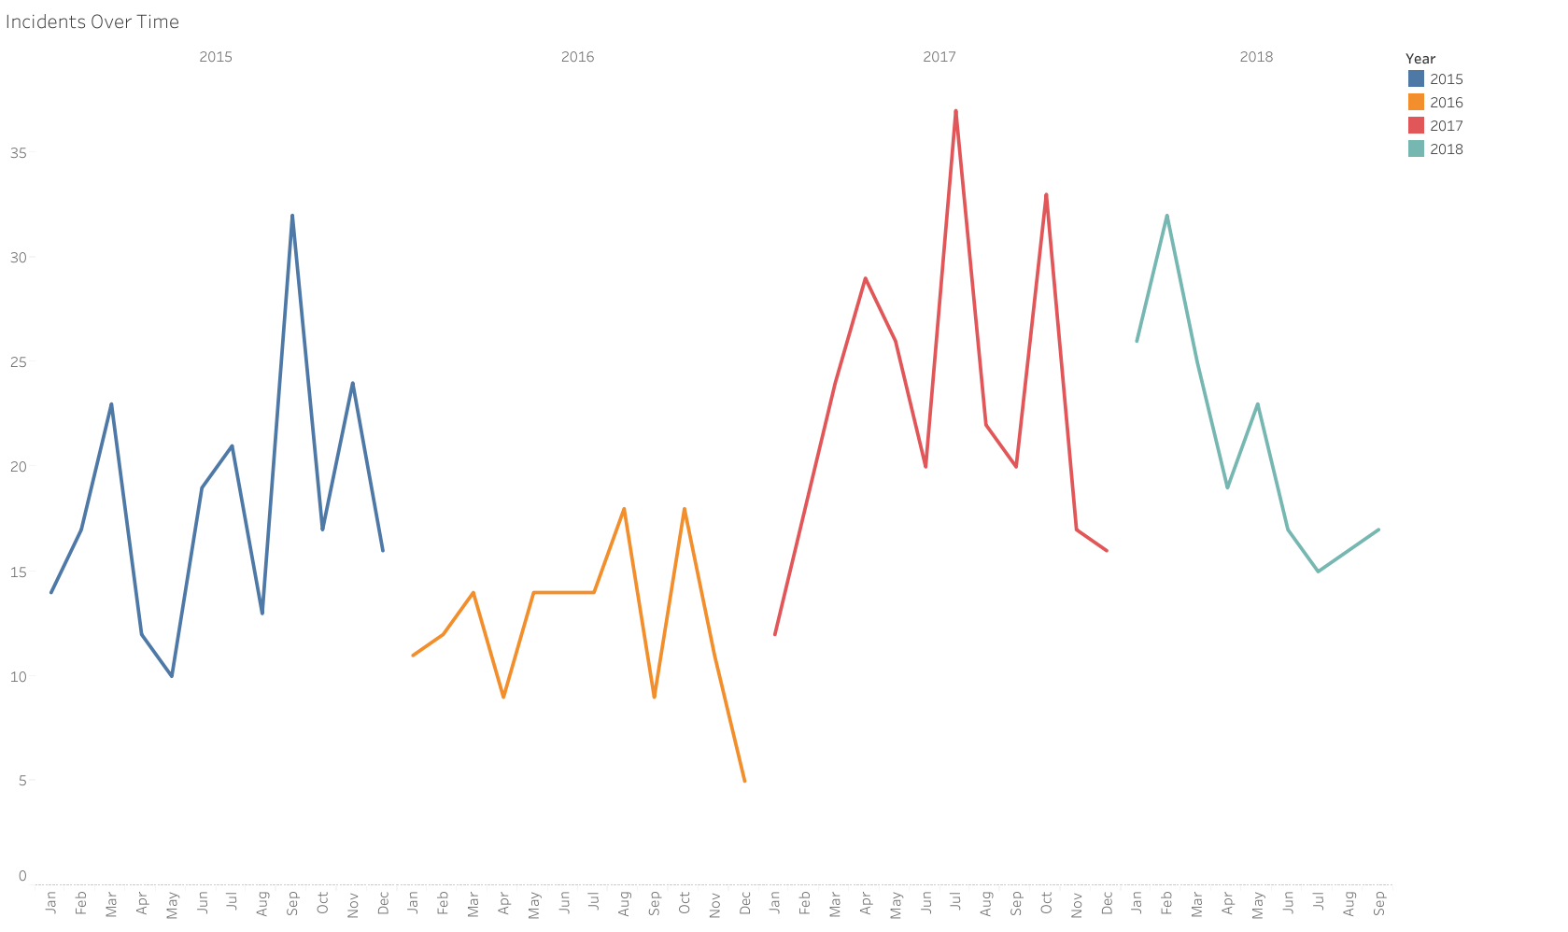

Slide 6
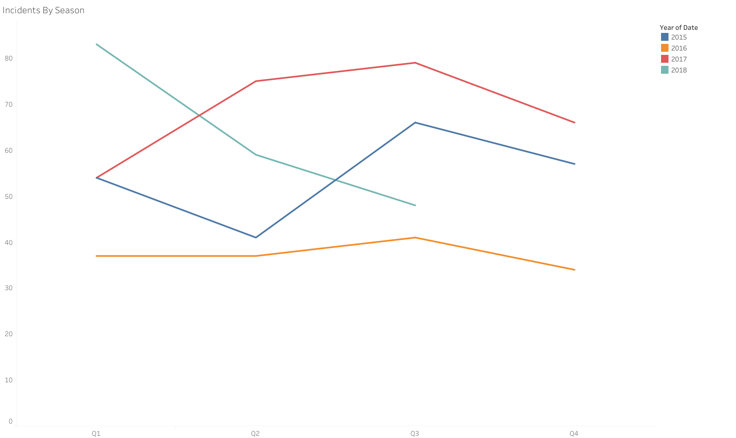

Slide 7
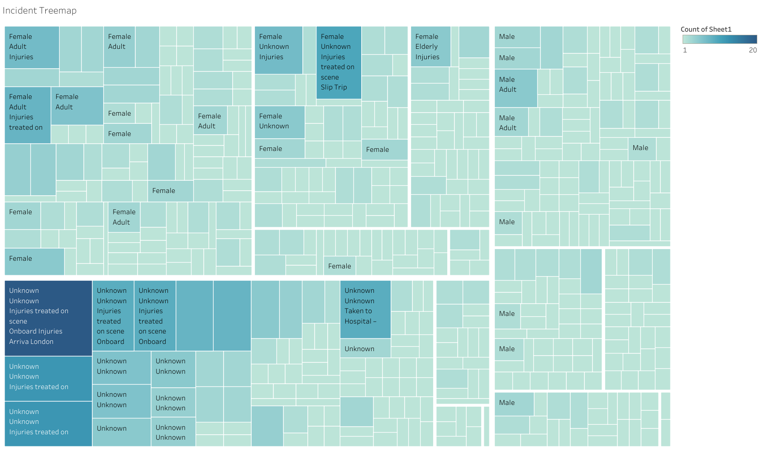

Slide 8
